Slide 1
Update on Charity Accounting and Audit Winter 2022

Slide 2
Audit changes affecting December 22 audits onwards:
Revised ISA 315
Revised ISA 240
Audit of pension schemes
Next SORP
Charity commission updates – CC14 and CC8
Kids Company report
New FRS102
Carbon reporting
IFR4NPO
Charity governance code
Charities Act 2022

Slide 3
Audit changes affecting December 2022 audits onwards
ISA 315 and 240

Slide 4
Applies to financial periods beginning on or after 15 December 2021, so 31 December 2022 year-ends onwards but watch out for short periods
The new standard attempts to clarify and improve audit work around:
Identifying significant risks and their nature and impact
Understanding internal controls and systems
Understanding IT and cyber risk
Revised ISA 315:
Identifying and assessing the risks of material misstatement

Slide 5
Key parts around how auditor assesses different risks within your charity:
Financial statement risk: Risks that affect financial statements as a whole - risk of inaccuracies that affect material or large balances within them
Spectrum of risk covering:
Assertion Risks: Risks of misstatements on specific elements of balances and figures e.g. the completeness of income or the accuracy of a building valuation
Inherent risk: risks that are natural or inherent in your activities with the existing level of controls. e.g. complexity of accounting estimates you use or an unusual structure making transactions hard to track
Control risk: risk that material misstatement could not be prevented, or detected and corrected by your system of internal control
Risks can exist on a spectrum from high to low and your auditor needs to document and assess each of the risks and their interaction in planning
Revised ISA 315: Identifying and assessing the risks of material misstatement

Slide 6
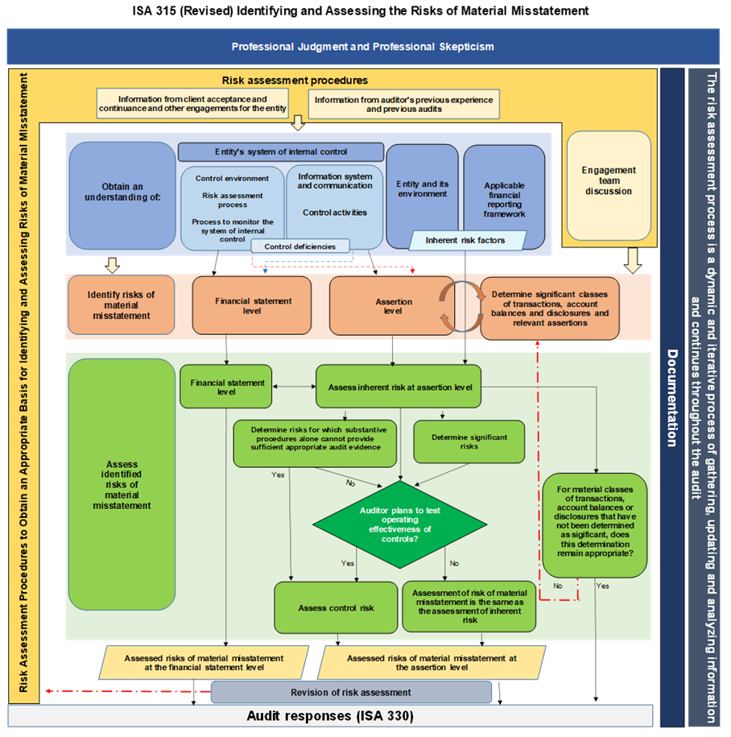
Extract from ISAAB guidance on new ISA 315

Slide 7
How does it affect me? Some are updates and some are new
Your auditor will need to document and understand several key aspects with you including:
Your Business model: What are the scope of your activities? What is your structure? Do you operate in any risky areas or difficult scenarios?
Understand your operation in detail including how your apply resources such as people and cash, and the outputs they create
Understand the role of IT and systems within that model and how they contribute (more on IT later…)
Understand what risks you see in your own model – going concern/reliance on key funders/use of brand or reputation/dwindling member numbers or customers..
Revised ISA 315: Identifying and assessing the risks of material misstatement

Slide 8
Your auditor will need to document and understand several key aspects with you including:
Your internal controls: What is your control environment like – and the culture and training of your staff?
How does you perform risk assessments and do you consider the risks in your controls?
What is your monitoring and oversight process? Are Directors / Trustees involved at all?
How do you capture and store information, records and details. Is your data secure and an easy to follow trail or process?
Finally specific key controls themselves – need to know control and review points along your internal systems and how they work
Revised ISA 315: Identifying and assessing the risks of material misstatement

Slide 9
Your auditor will need to document and understand several key aspects with you including:
IT systems and controls: Most significant new area with auditors expected to document in detail how your IT systems work and controls within.
What software do you use? Is it off the shelf systems with ‘ready made’ controls and reporting? Or is it bespoke and needs much more detail for your auditor on how it works and how risks are managed?
What role does it play in your business model? Are you reliant for example on a CRM system to identify and bill members? Or a donor database to ensure all your regular donations are complete and accurate?
How familiar are your staff with the system and what training do they have? Is it a brand new system this year?
Revised ISA 315: Identifying and assessing the risks of material misstatement

Slide 10
Key takeaways:
Need to discuss your business model and operations in more detail at the planning stage
Need to understand your IT systems and controls around IT in more detail – so that your auditor can assess the risk
Need to detail your key controls and explain how they reduce your risks
More documentation, and more work for auditors at the planning stage
Help in summarising your systems and controls – Finance manuals
Revised ISA 315: Identifying and assessing the risks of material misstatement

Slide 11
Applies to financial periods beginning on or after 15 December 2021, so 31 December 2022 year-ends onwards but watch out for short periods
The new standard attempts to clarify and improve audit work around:
Understanding and identifying potential fraud risks
Obtaining solid and appropriate evidence
Responding appropriately if fraud identified during the audit
Evolution of current standard not revolution - builds and amends the existing requirements
Revised ISA 240: The Auditor's Responsibilities Relating to Fraud in an Audit of Financial Statements

Slide 12
Where does the new standard affect our work?
More discussion on fraud not just with management but with Directors / Trustees. Asking how you identify fraud in your charity? How comfortable are you with the current systems and controls? What is the history – any frauds in the past and how did you react?
More careful evaluation of audit evidence including use of specialists to evaluate complex areas where required
Tailoring our audit report to tell you what work we did on identifying and assessing fraud or irregularities in your charity
Enhancing our communication of issues and ensuring that management and Directors / Trustees are included in discussions
Requirement to ‘stand back’ at conclusion of the audit and assess risks, our procedures, and our audit evidence to conclude on whether financial statements are materially misstated due to fraud
More documentation, more evidence required in some cases
Revised ISA 240: The Auditor's Responsibilities Relating to Fraud in an Audit of Financial Statements

Slide 13
Key takeaways – things you will be asked:
Do you have appropriate evidence to support complex estimates or balances in your accounts? Pensions, investments, buildings
Does your charity address incentives to manage earnings or KPIs to deceive users of the financial statements?
Have you got economic, industry or operating conditions that give rise to particular risks, and any frauds in the past?
Have you considered the extent of segregation of duties and whether this could be overridden?
Have you considered how Directors / Trustees and management promote a culture of honesty and integrity – does your charity have a whistle blowing policy?
Have you got adequate knowledge of employees’ competence, training and attitudes?
Revised ISA 240: The Auditor's Responsibilities Relating to Fraud in an Audit of Financial Statements

Slide 14
Audit of FRS102 asset/liability of Defined Benefit Pension Schemes: Requirement to obtain better and more detailed evidence
In its recent monitoring reports, ICAEW has drawn attention to audit of defined benefit pension schemes and how auditors obtain sufficient and appropriate evidence. Key areas include:
Your auditor needs direct access to communicate at an early stage with your actuaries or custodians of scheme
More evidence needed around the underlying assets of scheme and evidence of their existence
More evidence needed around asset allocation and how your actuary calculated balance on your scheme
More evidence about make-up of your employees, such as salary, age and gender profile in order to check accuracy against those used in scheme valuation
Need to question assumptions and rates used directly with the actuary
Overall more complex and time consuming so early access to actuaries is crucial

Slide 15
Next Charities SORP
Expected in 2024
For periods beginning on or after 1 January 2025

Slide 16
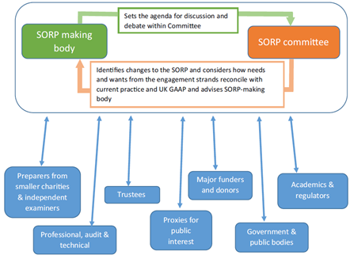
SORP Making Process
Engage stakeholders more effectively and act more quickly on feedback

Slide 17
Professional and technical (Group B)
Price Bailey involved in engagement strands
Believe there is scope for reform of the SORP across a wide range of topics
Asked to review several areas
summary financial information/key facts page
reserves
impact reporting
support costs
presentation of SOFA – start with expenditure
removal of the use of comparison information
permit charities to use accrual basis of accounting for grants
tiered reporting
sustainability reporting
financial notes
income recognition
legacies
donated goods and services
expenditure classification
funds note
activity reporting
materiality

Slide 18
Professional and technical (Group B)
Key changes asked for which are currently not seeming to be taken forward
Wishes:
Reduction in requirements for comparatives
The development of a tiered approach to requirements with a focus on ‘think small first’ or on requirements for ‘less complex entities’
Changes to the recognition of income and funding commitments – accruals accounting to be allowed or grants?
Remove the requirement to allocate support costs with natural classifications used instead for smaller entities to be extended?

Slide 19
to ensure charity is publicly accountable to its stakeholders for the stewardship and management of funds it holds on trust
consider information needs of primary users of report. Vary from charity to charity but normally include funders, donors, financial supporters, service users and other beneficiaries
Purpose of the Report is….

Slide 20
Greater focus on the report and accounts together telling the story of the charity, including reporting reserves To reinstate a definition of reserves in SORP. Noted that larger charities abandoning reserves for a liquidity statement
‘It is important that it is understood that reserves are not about winding up a charity but about how the charity operates and manages its resources from a risk-based approach. Reserve information is about the charity operating on a going concern basis and reporting.
Compulsory impact reporting requirements
Summary information/key facts - encouragement rather than the introduction of additional reporting requirements
Some areas of change which would affect you

Slide 21
Charity Commission

Slide 22
Recent court cases like ‘Butler-Sloss v Charity Commission’ highlighted issue of what investment powers charities should have and how much attention they need to pay to issues of ethical investing
‘Harries v Church commissioners’ in 1992 considered whether a charity could invest for maximal financial return, even if those investments contradict with a charity’s purpose. In this case the main principles set by the court were:
Consider where an investment directly conflicts with charity’s purposes
Consider where an investment indirectly conflicts with charity’s purposes - e.g. where particular investments might alienate supporters or donors or make beneficiaries less willing to accept help because of source of charity’s money
Trustees must not use property held by them for investment purposes as a means of making moral statements at expense of their charity, although they may if they wish accommodate the views of those who consider that on moral grounds a particular investment would be in conflict with objects of charity, provided that trustees are satisfied that that course would not involve a risk of financial detriment
The greater the risk of financial detriment, the clearer trustees will need to be of the advantages to the charity of the course of action they are adopting
CC14 Charities and Investment matters – proposed changes

Slide 23
Butler Sloss
Trustees wanted to exclude, as far as practically possible, investments that are not aligned with environmental goals
Trustees were concerned that adopting such an investment policy might not be lawful and consistent with their duties, as it may lower their returns following previous case
Main issue in this case was whether previous decision laid down an absolute prohibition against charity trustees making investments that directly conflicted with their charities’ purposes, or whether this was always a discretionary exercise by trustees
The decision:
High Court confirmed that there is no absolute prohibition and that trustees enjoy exercise of discretion when making investment decisions
Trustees must consider the sources of their powers of investment in particular within their charities’ governing documents and sections 3 and 4 of the Trustee Act 2000 (where applicable) and that charity trustees can take into account non-financial considerations when exercising their powers of financial investment
Trustees’ overriding duty is to further their charities’ purposes (as set out in Charity Guidance CC3)
CC14 Charities and Investment matters – proposed changes

Slide 24
What now? CC14 guidance to be updated and released in summer 2023
Redesigned guidance will incorporate an updated explanation of social investment, which is distinct from financial investment and is currently covered in separate guidance
Update and explanations on duties that trustees have when making financial investments
Discretion trustees have to decide whether or not to adopt a responsible investment approach
Adding straightforward structuring and examples where helpful
‘should give trustees confidence about the options open to them for investing their charities’ funds and about making investment decisions that serve their charities’ best interests within the limits of the law.’
CC14 – new version due Charities and Investment matters

Slide 25
Charity Commission will be updating CC8 in new year
Need to be away and consider implications on your organisation of changes
Have you currently assessed you compliance and control environment against the control checklist in the Appendix?
By making statement on risk and controls in your Trustees report you are affirming that you have done so
Internal Controls Charities Commission guidance

Slide 26
High Court’s Judgement was given on 12 Feb 2021 concluded that:
whilst aspects of it were high risk, Charity’s operating model was not unsustainable in principle. Charity experienced significant cash flow difficulties as costs accrued evenly, but donations were seasonal giving rise to cash flow difficulties
Charity recognised that it could not continue to increase in scale to meet demand without changing its funding. Trustees reasonably believed additional funding could be obtained, and had developed a contingency response as discussions with the Government were pursued
Charity had a full-time permanent executive, in addition to CEO, whose expertise trustees were legitimately entitled to rely upon, and they did so
Charity had formulated a restructuring plan. If it had not been for the unfounded sexual assault allegations it is more likely than not that the restructuring would have succeeded, and Charity would have survived
Judge concluded that ‘most charities would, I would think, be delighted to have available to them individuals with the abilities and experience that the Trustees in this case possess’ and that it is vital that able and experienced individuals are not dissuaded from becoming or remaining trustees. The Judge stated that she had a great deal of respect for the care and commitment the trustees had shown in highly challenging circumstances.
Kids Company
Charity Commission has published its findings on 10 Feb 2022
https://www.gov.uk/government/publications/charity-inquiry-keeping-kids-company/charity-inquiry-keeping-kids-company

Slide 27
Charity Commission disagreed with some elements of High Court decision
The trustees were aware of these risks and continued to operate the Charity under the same model for many years, only developing a restructuring plan in the last months of charity’s operation
Per the Charity Commission, lessons from Kids Company fall into four broad areas:
the importance of checks and balances, and the right blend of skills and knowledge, in charity boards. In particular – terms of office, diversity and skills on the Board
requirement for operating models to reflect the nature and scale of the charity
role of financial planning and reserves policies
considerations when charities grow
Kids Company
Charities Commission Report

Slide 28
New FRS 102
FRS 102 will now be updated for periods commencing on or after 1 January 2025
Exposure draft is still expected during 2022 (? Likely 2023 now)
IASB is to consult on changes to IFRS for SMEs and this has had an impact on timescale for periodic review
Carbon Reporting
More charities are voluntarily reporting on climate change and carbon footprint
Such information requests are also in grants applications from funders
All charities should consider voluntarily disclosure in their statutory accounts
Other updates

Slide 29
New FR4NPO
New International Non-Profit Accounting Guidance (INPAG)
IFR4NPO Project has reached a major milestone
Exposure Draft 1 was released on 21 November 2022
Can submit comments until 31 March 2023
https://www.ifr4npo.org/ed1/?utm_source=CFG+Web+Subscribers&utm_campaign=5f4c624f8e-Fortnightly+newsletter_COPY_01&utm_medium=email&utm_term=0_d9d5e7cf12-5f4c624f8e-294792597
Other updates

Slide 30
The Charity Governance Code 2020: the new App
Likely to become compulsory under next SORP?
Governance App is a new free resource for the charity sector. Managed by the Directory of Social Change
Questionnaire consists of 70 questions and it follows the Charity Governance code. Can be found here: https://thegovernanceapp.org.uk/
Designed to help charities get started on their governance review journey
Charities can register for free and then engage with whole Board to review their governance. Each board member completes the questionnaire and the app then collates results to help form a picture of the governance of the organisation
Great way to get started on a governance review and to be able to form a picture of the organisation – what works well and what may need to be addressed
Other updates

Slide 31
Paying trustees for providing goods to charity
Charities already have a statutory power that they can use, in certain circumstances, to pay trustees for providing a service to the charity beyond usual trustee duties, or goods connected to that service.
Now under Charities Act 2022, charities will be able to pay trustees in certain circumstances for just providing goods
So trustees could be paid for:
services only, for example estate agency or computer consultancy
services and associated goods, for example plumbing or painting service and any associated materials such as plumbing parts or paint
And Now - goods only, for example supplying stationery to the charity
Charities Act 2022
Changes which were passed in October 2022

Slide 32
Fundraising appeals that do not raise enough or raise too much
Sometimes, appeals do not raise amount needed or raise too much or circumstances may change and cannot use donations as you intended
Now the Charities Act 2022 has reduced complexity surrounding what trustees need to do in these situations. For example:
previously in some circumstances charities had to wait six months for donors to ask for a refund no longer applies
simpler process for obtaining Charity Commission authority which no longer needs a scheme
if donations that can be spent on new purposes (different to the purposes you raised them for) are less than £1000, trustees can act without the Commission’s involvement if they comply with new legal requirements
Charities Act 2022
Changes which were passed in October 2022

Slide 33
Power to amend Royal Charters
Charity Tribunal power to make “authorised costs orders” for proposed/ongoing Tribunal proceedings out of the funds of the charity
Commission’s scheme-making powers include making schemes for charitable companies
confer trust corporation status automatically to existing/future corporate charities in respect of any charitable trust of which the corporation is (or, in the future, becomes) a trustee
update provisions relating to giving public notice to written consents and orders of Charity Commission under various sections of Charities Act 2011
changes to governing document by parliamentary scheme, under section 73 of the Charities Act 2011, will by default always be under a lighter touch parliamentary process (negative parliamentary procedure)
Charities Act 2022
Changes which were passed in October 2022 – other more specific changes

Slide 34
The implementation plan for future changes includes:
changes to how charities sell, lease or transfer land (due to come into effect in spring 2023)
greater flexibility to make use of ‘permanent endowment’ – this is money or property originally meant to be held by a charity forever (due to come into effect in spring 2023)
changes to how charities can amend their governing documents (due to come into effect in autumn 2023)
Charities Act 2022
Changes are expected to come into force in autumn 2022, spring 2023 and autumn 2023

Slide 35
Contact us
Helena Wilkinson
Charities partner
07921 353540
Helena.wilkinsson@pricebailey.co.uk
Michael Cooper-Davis
Charities partner
07557 758634
Michael.cooper-davis@pricebailey.co.uk
Suzanne Goldsmith
Charities director
07557 758634
Suzanne.goldsmith@pricebailey.co.uk

