Slide 1
HR/Employment Law update APRIL 2023
Presented by
Claire Berry and Joanna Smye

Slide 2
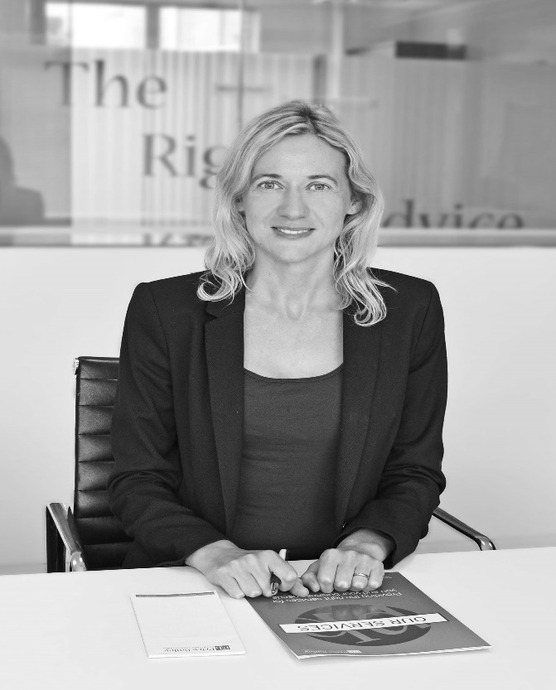
Claire Berry
Employment Solicitor
claire.berry@pricebailey.co.uk
DDI: 01223 941293
Mob: 078269 92601
Joanna Smye
Employment Solicitor
joanna.smye@pricebailey.co.uk
DDI: 01223 941278
Mob: 07880 202473

Slide 3
Topics for discussion
Disability discrimination – when does the duty to make reasonable adjustments arise?
Disability discrimination – in what circumstances does discrimination arise from disability?
Redundancy – the importance of meaningful consultation.
Misconduct – the importance of following a fair procedure.
What’s on the horizon – 2023/2024.

Slide 4
Disability Discrimination
A recap
Definition of disability
An employee is disabled if they have:
a physical or mental impairment
which has a substantial and long term effect
on their ability to carry out their normal day- to- day activities.
When does the duty to make reasonable adjustments arise?
The duty arises where a disabled person is placed at a substantial disadvantage by either:
an employer’s provision, criterion or practice;
a physical feature of the employer’s premises; or
an employer’s failure to provide an auxiliary aid.

Slide 5
Disability Discrimination
When does the duty to make reasonable adjustments arise?
Hilaire v Luton Borough Council [2002] EAT 166.
Background
The Employment Appeal Tribunal had to consider whether the duty to make reasonable adjustments arose where a disabled employee refused to participate in an interview forming part of a redundancy process.

Slide 6
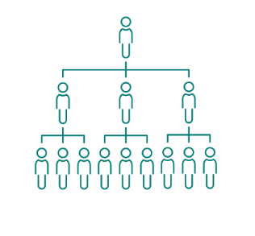
Facts of the case (Hilaire v Luton Borough Council)
The claimant suffered from depression and arthritis.
As part of a restructuring process, he was required to apply and interview for a role in his employer’s new structure. He was provided with extra time and support to complete his application.
He declined to attend an interview and was later dismissed by reason of redundancy.
The claimant brought a reasonable adjustment claim, among other claims.

Slide 7
Outcome
The EAT found that the tribunal had been entitled to dismiss the claim on the basis that the provision, criterion or practice did not cause the disadvantage.
The real reason for his non-participation was because he had lost confidence in his employer.
His reasonable adjustments claim therefore failed.
The EAT observed that slotting him into a role was objectively a step which would have alleviated any disadvantage, but it would have affected other potential redundant employees.

Slide 8
Impact
This case is a reminder that when it comes to making reasonable adjustments:
The duty only arises when an individual is placed at a substantial disadvantage in comparison with a person who is not disabled.
The duty is to make reasonable adjustments only- there is no requirement to take measures that would impose a disproportionate burden on the employer.
If you are unsure as to what adjustments would be reasonable, seek medical advice.
Please note that the duty to make reasonable adjustments will not arise unless the employer knows or ought reasonably to know of the disabled person’ disability and that the disabled person is likely to be placed at a substantial disadvantage.
Key points to take away from this case

Slide 9
Discrimination arising from a disability
Background
Discrimination arising from disability arises where:
A treats B unfavourably because of something arising in consequence of B’s disability ( rather than because of the disability itself); and
A cannot show that the treatment is a proportionate means of achieving a legitimate aim.

Slide 10
Facts of the case (McAllister v Revenue and Customs Commissioners)
M suffered from anxiety and depression and was off work for long periods of time, although some of these absences were not related to his mental health issues.
M was absent from work for a total of 245 days on 23 different occasions.
In late 2018, HMRC concluded that M’s absence impacted on productivity and staff morale and that all reasonable adjustments had been exhausted and he was dismissed with immediate effect.
The claimant brought claims before an employment tribunal of, among other things, discrimination arising from disability in relation to his dismissal.

Slide 11
Outcome
The EAT agreed with the ET that although he was dismissed due to something arising as a consequence of his disability, HMRC could objectively justify the unfavourable treatment.
In the EAT’s view, the tribunal had made a permissible finding that the aim of ensuring that staff were capable of demonstrating satisfactory attendance and a good standard of attendance was legitimate and corresponded to a real need on the part of HMRC.

Slide 12
Key points to note
What can employers learn from this decision?
Where an employer has followed a reasonable process and has put in place significant support to help the individual return to or remain at work, and/or their continued absence is having a wider impact on the organisation, then it may be possible to terminate their employment where this can be objectively justified.
To be proportionate, the unfavourable treatment has to be both an appropriate means of achieving the legitimate aim and reasonably necessary means of doing so.
A final point to note is that, as with the duty to make reasonable adjustments, an employer cannot be liable for discrimination arising from disability unless it knew, or should have known, about the claimant’s disability.

Slide 13
Discrimination arising from a disability
McQueen v General Optical Council [2023] EAT 36
The Employment Appeal Tribunal had to consider whether an employee’s ‘meltdowns’ in the workplace arose from his disabilities.

Slide 14
Facts of the case (McQueen v General Optical Council)
The claimant has dyslexia, some symptoms of Asperger’s Syndrome, left-sided hearing loss and neurodiversity, which caused him some difficulties with his interactions in the workplace.
In April 2015 he challenged an instruction from a senior colleague, in a rude and disrespectful manner, with aggressive gestures and inappropriate body language.
In April 2016 the claimant was challenged about his habit of standing up at his desk and speaking loudly to colleagues.
The claimant brought an employment tribunal claim that he had been subjected to unfavourable treatment because of something arising in consequence of disability.

Slide 15
Outcome
The tribunal considered all medical evidence and found that the claimant’s insistence on standing up arose out of habit, not as a consequence of his disabilities.
The incidents in which the claimant’s disagreement with instructions led to conflict, the tribunal found that these arose because he had a short temper and resented being told what to do.
The claimant appealed to the EAT on the basis that the disability does not necessarily need to be the sole or even main reason for the “something” that arises in consequence of it. The EAT rejected the appeal.

Slide 16
Key points
Points to take away from this case
There must be a connection between the “something” leading the unfavourable treatment and the disability.
Where the claimant suffers from several distinct disabilities, all of which can have varying symptoms, it may be difficult to predict whether a particular kind of behaviour is something which arises in consequence of one or more disabilities.
Medical advice should be sought on each occasion.

Slide 17
?

Slide 18
REDUNDANCY
A recap
Redundancy as the reason for termination of employment:
One of the potentially fair reasons for dismissal.
Is there a genuine redundancy situation?
What does a fair procedure involve?
Consider alternatives to redundancy at the outset and throughout the process.
Meaningful and timely consultation.
Fair selection.
A reasonable search for suitable alternative employment.
NB: collective redundancy process has additional obligations.

Slide 19
Background
Consultation is a key requirement of any redundancy process.
It must give employees the potential to influence the outcome of the process.
Case
Mrs Mogane v Bradford Teaching Hospitals NHS Trust [2022] EAT 139

Slide 20
Facts of the case (Mrs Mogane v Bradford Teaching Hospitals NHS Trust [2022] EAT 139)
This claim related to a redundancy process which involved 2 nurses on fixed term contracts.
Ms Mogane had over 2 years services on successive fixed term contracts, but the Trust chose to make her redundant because her contract was up for renewal first.
The Trust made this decision before any meetings or consultation took place with her, and was unable to explain why it was reasonable to make that decision without consultation.

Slide 21
Outcome
The EAT found that the selection of Ms Mogane was arbitrary, because it related solely to the date on which her fixed-term contract ended.
Given that she was chosen for dismissal before any consultation took place, the EAT substituted a finding that she was unfairly dismissed.

Slide 22
Recommendations
In order that consultation is genuine and meaningful, consultation must take place at a formative stage when an employee can still potentially influence the outcome. So, for example, if consultation is only in relation to whether or not alternative employment is available, this is not sufficient.
A pool of one is not always unfair, but it is not advisable if you have more than one employee doing similar work or having interchangeable skills. Normally, it is advisable to have a number of factors which determine which employees are selected for redundancy, rather than just one thing.
Importantly, whatever pool you identify, employees should always have the opportunity to comment on the selection process, as part of meaningful consultation.
Key learning points

Slide 23
What if an employee claims that their redundancy was an unfair dismissal?
The EAT reminded first tier Tribunal judges that when deciding Tribunal claims for unfair redundancy dismissal, they should always investigate three questions, even if they are not raised by the parties. These are:
Has there been sufficient warning and consultation about the redundancy proposals?
Has there been a fair selection process?
Did the employer undertake a reasonable search for alternative employment?
This is an exception from the general rule that employment tribunals are only required to investigate issues raised by the parties.
Case
Mrs Osinuga v BPP University Limited [2022] EAT 53

Slide 24
What are some other potential pitfalls in a redundancy process?
Considerations
The issue of suitable alternative employment and the special status of employees on maternity leave.
Discrimination in general.
When to settle?

Slide 25
?

Slide 26
MISCONDUCT
A recap
Misconduct as the reason for termination of employment:
One of the potentially fair reasons for dismissal.
Is misconduct the real reason for dismissal?
To dismiss fairly for misconduct an employer has to show that:
The conduct was the real reason for the dismissal .
It was reasonable to dismiss in the circumstances after following a fair process.

Slide 27
Background
The Employment Tribunal had to consider whether on the facts the claimants had been unfairly dismissed.
Case
Ms C Hawley v Ms R Hawley v Direct cleaning services SW Ltd 1406210/2020 & 1406303/2020

Slide 28
Facts of the case (Ms C Hawley & Ms R Hawley v Direct cleaning services SW Ltd 1406210/2020 & 1406303/2020)
In July 2020 their employer received a complaint from the museum about their poor standard of cleaning and this was followed by further complaints in August 2020 alleging that they had been rude and abusive to staff at the museum.
On 21 August 2020 the employer sent letters to the claimants which stated that they had been suspended on full pay pending further investigations of “multiple allegations of gross misconduct” but gave no details.
They tried to call their employer to try and determine the substance of the allegations but no information was provided and no investigation took place.
On 1 September 2020 both claimants received a letter confirming their dismissal. They claimed unfair dismissal.

Slide 29
Outcome
The tribunal held that the claimants were unfairly dismissed.
It reached this decision because the claimants were not:
provided with factual details about the alleged gross misconduct
invited to attend any disciplinary meetings
given an opportunity to respond to those allegations and put their side of events.

Slide 30
The right approach
Key points to note
When dealing with misconduct issues it is important to follow the ACAS Code of Practice on disciplinary procedures. This involves a number of steps including:
An employer should carry out any necessary investigations to establish the facts of the case.
An employers should inform employees of the basis of the problem and give them an opportunity to review any evidence and to put their case in response before any decisions are made.
Employees are entitled to be accompanied at any formal disciplinary meeting.
Allow the employee the opportunity to appeal.
A failure to comply with the Code may result in an uplift of up to 25% being made to any compensatory award.

Slide 31
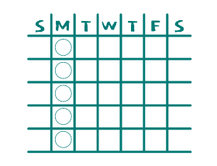
Background
An employee was dismissed for calling in sick.
The tribunal had to determine whether she had been fairly dismissed taking into account the facts and the procedure followed by the employer.
Case
Miss C Thorley v Mr C Donnelly t/a Acute Barbers and Cathays Barber Shop Ltd t/a Acute Barbers 1600112/2022

Slide 32
Facts of the case (Miss C Thorley v Mr C Donnelly t/a Acute Barbers and Cathays Barber Shop Ltd t/a Acute Barbers 1600112/2022)
The claimant began working for her employer in 2018 and initially she got on well with the owner. However their relationship became strained due to the claimant’s sickness absence, with her sick days mainly falling on Mondays.
On the last weekend of October 2021, the claimant arranged a house party. The owner’s words when she left work on Friday were “don’t let me down on Monday”.
However on that Monday morning, the claimant sent a text saying “ I know you’re going to be mad but I can’t work. I was a mess yesterday and I’ve woke up this morning and was sick straight away”. The owner replied with “I’m not having this. I’m letting you go”.
The claimant protested and in response the owner said “after four years of phoning in sick on Mondays because you have had a good weekend, I can do what I like, trust me”.

Slide 33
Outcome
The tribunal concluded that the claimant had endometriosis at the time she was dismissed and upheld her claim for unfair dismissal as the employer had acted unreasonably by:
Not previously discussing her attendance record with her
Not issuing her with a formal warning about her attendance record
Not carrying out a fair and reasonable investigation and disciplinary procedure in relation to this incident
Not giving her the opportunity to provide an explanation before she was dismissed
Dismissing by text.

Slide 34
Recommendations
Points to note
In any situation it would be wrong to make assumptions without first following a fair process.
For example in this case repeated sickness absence that has a clear pattern, such as always falling on Mondays, could potentially have been grounds for dismissal, but to automatically assume that the sickness absence is fraudulent without following any process, means that the employee is denied an opportunity to put forward a valid explanation.
In all cases you should follow a fair process including:
Properly investigating and presenting the findings to the employee
Allowing the employee an opportunity to provide an explanation
Managing the employee with appropriate warnings
Where relevant, giving the employee an opportunity to improve
Otherwise an employer risks an unfair dismissal claim.

Slide 35
?

Slide 36
NMW, SMP, SPP SSP rates
Statutory redundancy weekly cap (impact on basic award)
Compensatory award
Vento bands
April 2023
What has gone up?

Slide 37
What’s on the horizon?
Flexible working
The Employment Relations (Flexible Working) Bill would introduce a number of changes to the rules on the right to request flexible working, including allowing up to two requests a year and removing the qualifying service requirement.
Predictable hours
At the start of this year, the government confirmed its support for a private members’ bill to give workers the right to request a more predictable working pattern. The Workers (Predictable Terms and Conditions) Bill (WPTCB) provides that, if a worker’s existing work pattern lacks certainty in terms of the hours they work, the times they work, or if it is a fixed-term contract for less than 12 months, they can make a formal application to change their working pattern to make it more predictable.
Harassment at work
The Worker Protection (Amendment of Equality Act 2010) Bill would impose a duty on employers to take all reasonable steps to prevent overtly sexual harassment in the workplace, as well as reintroducing the obligation to protect employees against third-party harassment (being all types of harassment, not just sexual).

Slide 38
What’s on the horizon?
Enhanced redundancy protection
The Protection from Redundancy (Pregnancy and Family Leave) Bill would extend enhanced protection against redundancy so that it applies during pregnancy and for a defined period after returning to work, in addition to the existing period of maternity leave. Protection would also be extended to employees taking adoption and shared parental leave.
Neonatal leave and pay
The Neonatal Care (Leave and Pay) Bill would support parents of premature or sick babies by providing one week's leave for each week that their baby is in neonatal care, up to 12 weeks. The leave would be added to an employee's maternity or paternity leave and paid at the usual statutory rate.
Carer’s leave
The Carer’s Leave Bill would introduce the right for employees to take a least a week of unpaid leave in any year in order to provide care for a dependent needing long-term care.

Slide 39
What’s on the horizon?
Data protection and Digital Information
The Data Protection and Digital Information Bill was first introduced last Summer and paused in September 2022 so ministers could engage in a co-design process with business leaders and data experts. A revised Bill was submitted by the Science, Innovation and Technology Secretary in early March 2023.
Retained EU law
At the end of the Brexit transition period, a new category of UK law was created called retained EU law. The Retained EU Law (Revocation and Reform) Bill provides that most EU retained law will be revoked on 31 December 2023, subject to any exceptions stipulated in regulations made prior to that date. However it appears unlikely that there will be time to produce modified and/or replacement legislation by that deadline.
And finally….
Anti-strikes bill, TUC report on Long Covid, the Buckland Autism Employment Review, Whistleblowing review.

Slide 40
?

Slide 41
Thank you for attending today’s webinar
Does anyone have any questions?
Claire Berry
Employment Solicitor
DDI 01223 941293
M +44(0)7826992601
E claire.berry@pricebailey.co.uk
Joanna Smye
Employment Solicitor
DDI 01223 941278
M +44(0)07880 202473
E joanna.smye@pricebailey.co.uk

